Slide 1



















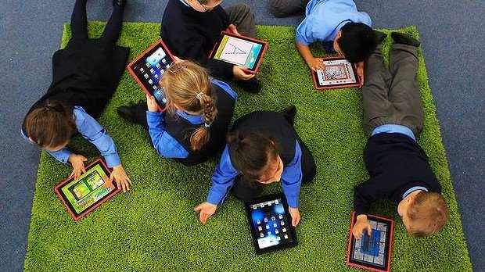
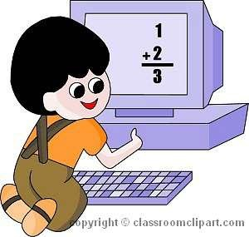
By Roshani Singh

Slide 2


Table of content
Introduction.
What is technology?
What is education?
Types of technology used in education.
Impact
Advantages.
Disadvantages.
conclusion
References.

Slide 3


Introduction
The era of 21st century is often regarded as an era of technology. Technology, today, plays a very important role in our life. It is seen as a basis of growth of an economy.
An economy which is poor in technology can never grow in
today’s scenario. This is because technology makes our work much easier and less time consuming.
The impact of technology can be felt in every possible field one such field is Education.

Slide 4



What is technology ?
Technology is a term that refers to a body of knowledge
That is employed to generate tools, create skills, and
choose materials for human use.
Technology includes the use of materials, tools, techniques, and sources of power to make life easier or more pleasant and work more productive.

Slide 5


What is Education?
Education in its general sense is a form of learning
in which the knowledge, skills, and habits of a group of people are transferred from one generation to the next through teaching, training, or research.

Slide 6


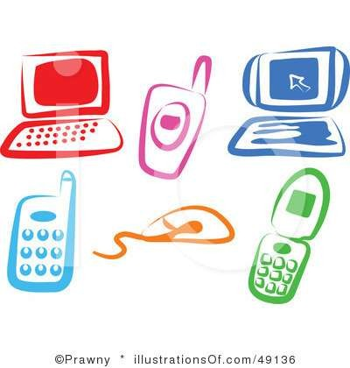
Type of technology used in education.
Smartbords
Classrooms pc
Projectors
Television

Slide 7


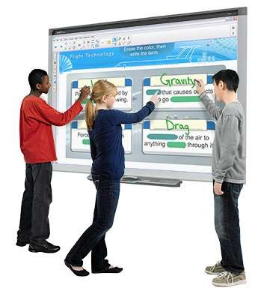
Smart boards
Smart board is an interactive white board that allows the teacher to project an image from a laptop to the front of the room and the teacher can then digitally draw on that image.

Slide 8


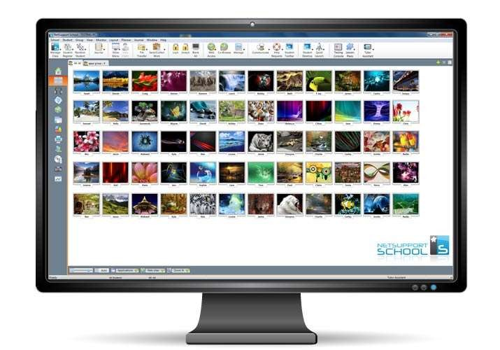
Classrooms PC
They give them the option of recording their notes for long period of time .
Most classes require student to do a lot of reports and presentations. You want a computer that will get this job done better than the rest.
This allows for students to be more in tune with their learning by allowing them to have their own personal computer.

Slide 9

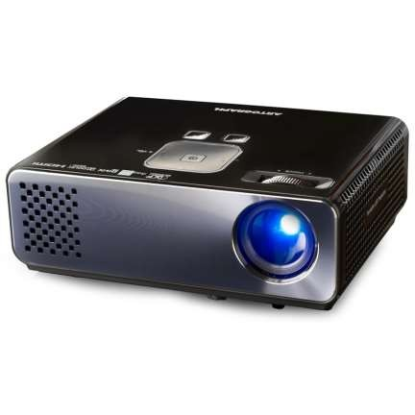
Projectors
Projectors hook up to the teacher's laptop and projects the screen from the laptop to the white board in the front of the room.
by doing this it allows students to see a larger version of what is on the laptop screen.

Slide 10
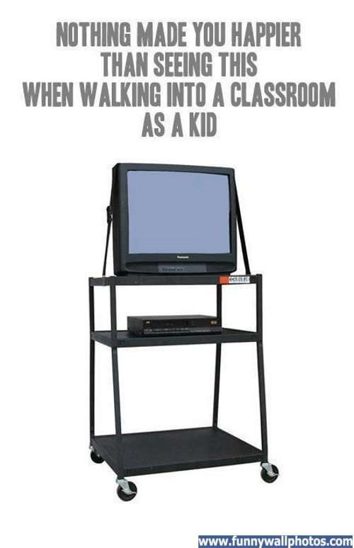


Television
Televisions can be used to show instructional DVDs or to be able to watch important current events, such as 9-11 or
presidential elections.

Slide 11



Globalization
When schools in different parts of the state , students can “meet" their counterparts through video conferencing without leaving the classroom.
Some sites, such as www.glovico.com are used to help students learn foreign languages online by pairing a group of students with a teacher from another country.

Slide 12


Advantages
It makes students more excited to learn
help students with busy schedules, freedom to work at home on their own time
train students to learn new technology skills they can use
later in the work place
Decrease paper and photocopying costs, promoting concept of "green revolution"

Slide 13

Disadvantages
Many experts and experienced people say that, due to such technology in education, students imagination is affected, their thinking ability is reduced.
Also its sometime time-consuming from teacher’s
point of view.
It is costly to install such technology.
There can be health issues too when used over limit.
some students can't afford modern computer
technologies

Slide 14



Conclusion
In the conclusion
Technology has a very positive impact on education and at the
same time may also pose negative effects.
Teachers, and students should take advantage of this in the good light and eliminate the drawbacks which are pulling back many of students as well as schools from achieving excellence
it is thus time for every country to introduce a
more technologically equipped education sector in the future.

Slide 15


